Slide 1


OCT 2020
WATER INCLUSION & INNOVATION PROJECT
Nsombi Lambright-Haynes, One Voice

Slide 2
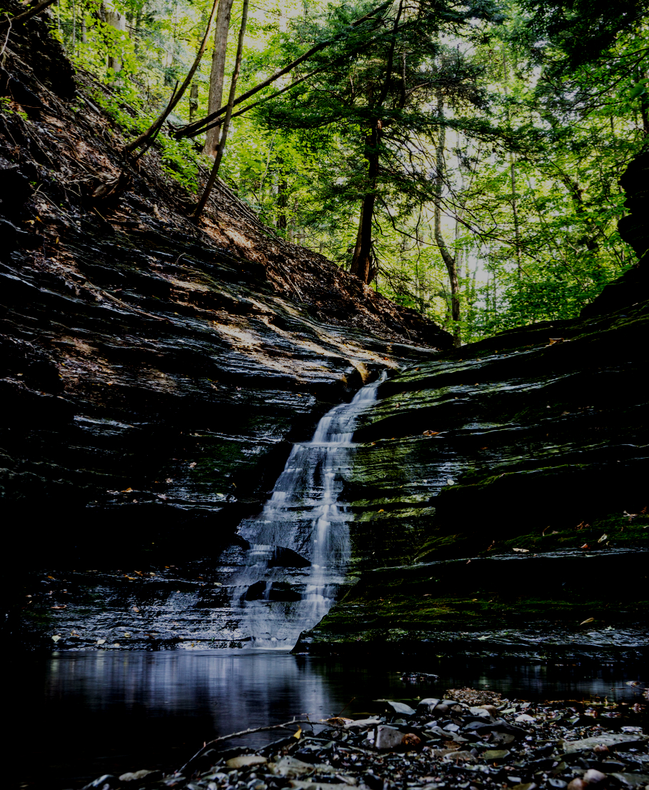
The Environment and Racial Equity
  Some of the most polluted environments are highly concentrated in communities where people are likely to be minority and/or low-income.
  These communities, particularly in southern states, have been traditionally selected as the homes of facilities that have been proven to negatively affect the environment i.e. hazardous waste landfills, coal-fired plants, or nuclear power plants.

Slide 3




Communities are aften disproportionately impacted by elements of the environment
Land
Air
Energy
Water

Slide 4
Historic Examples of Environmental Racism
1978
1982
1987
Emelle, Alabama, a community with over 90% African-American population, was selected as the site for a newly constuctured chemical wastle landfill that would receive more than 800,000 tons of waste from 42 states.
North Carolina state officials drafted plans to collect PCB-contaminated soils that were strewn along more than 200 miles of state roads and transfer the soil to a single landfill located in Warren County, one of only a few counties in the state with a majority black population.
Dr. Benjamin Chavis coined the phrase "Environmental Racism" to describe the direct relation between race and the frequency of hazardous waste sites placed near or in communities of color.

Slide 5
Historic Examples of Environmental Racism Cont.
1994
2005
2014
The results of EPA’s six month cumulative risk assessment study found that Chester, PA has the highest percentage of low-weight births in the state, nearly double the rate for the entire county, and a mortality and lung cancer rate that is 60% higher than the rest of Delaware County. In the mid-1980s, Chester, a predominantly African-American town was home to numerous hazardous waste treatment facilities.
Displayed response and assistance during Hurricane Katrina disproportionately ravaged the predominately Black areas of
New Orleans, Louisiana resulting in mass displacement and thousands of deaths.
The city of Flint, Michigan, changed its water source eventually leading to high concentrations of lead and other
contaminants in the water. This has led to an ongoing health crisis in the predominately Black and lower class population of the city.

Slide 6
Our Work
Electric Cooperative
Leadership Institute
Water Inclusion and Innovation Project (WII)
  Mississippi has the highest concentration of persistent poverty counties in the nation
  93% of the 353 persistent poverty counties in the U.S. are serviced by electric cooperatives.
  Many cooperative members in Mississippi spend in excess of 42% of their income on electricity.
  The Water Inclusion and Innovation (WII) Project which aims to ensure all communities have access to cost-effective, innovative sources to improve water/sewer infrastructure needs particularly as aging infrastructure disproportionately plagues low-income minority communities.

Slide 7
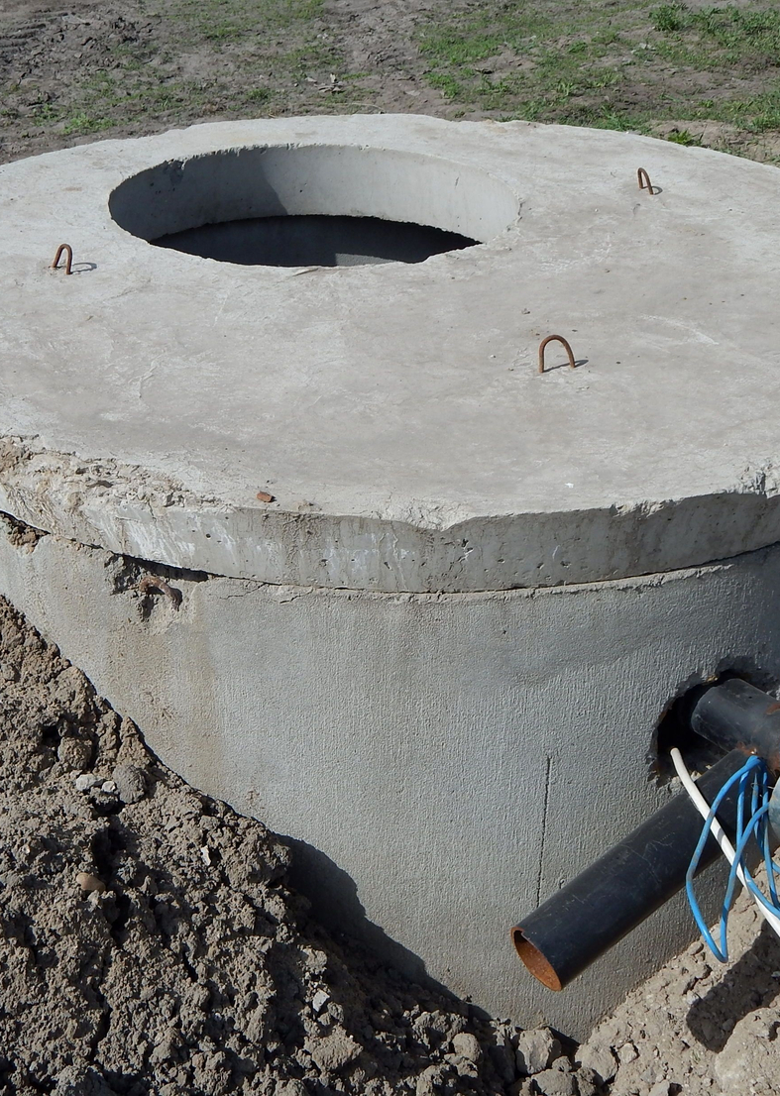
How does our EJ work impact the health and wellbeing of low-income communities of color?
Water Inclusion & Innovation
(WII)
Access to adequate finance used to build or update water infrastructure projects will allow communities to:
  Increase the availability of a community's overall water supply to all residents.
  Attract water dependent industries (certified business sites)
  Ensure public health is not compromised due to inadequate treatment

Slide 8
Aging and water infrastructure (water pipes, mains, treatment plants) often found in low-income communities, begs the question, is there a disproportionate allocation of federal funds to communities that are less needful financially?
Accounting for only race and per captia income, out initial findings in our 6-state pilot study illustrates a disproportionate allocation to varying extents. The initial findings have led to the need for a deeper dive to assess how needful communities can access funding sources to improve there water treatment and delivery system.
Water Inclusion & Innovation
(WII)

Slide 9
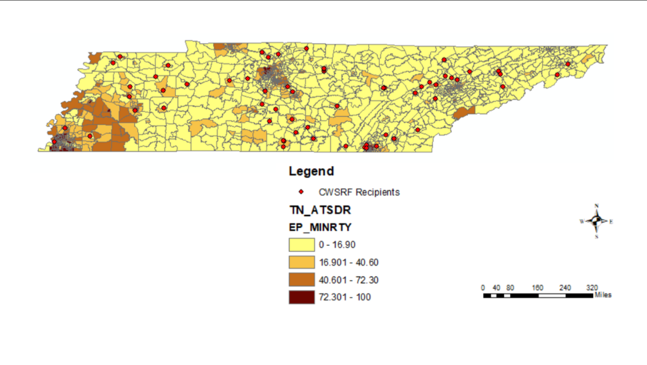
Majority of the Clean Water State Revolving Fund loans are allocated to areas that have a "low vulnerability rate", which are also normally areas with lower minority population.
Minority Percentage

Slide 10
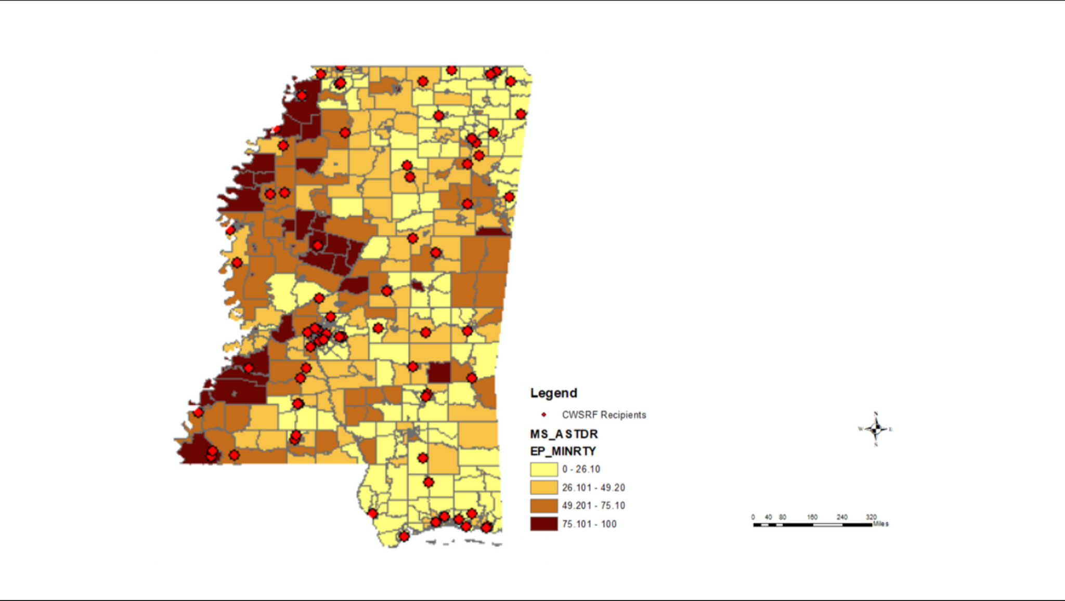
Minority Percentage

Slide 11
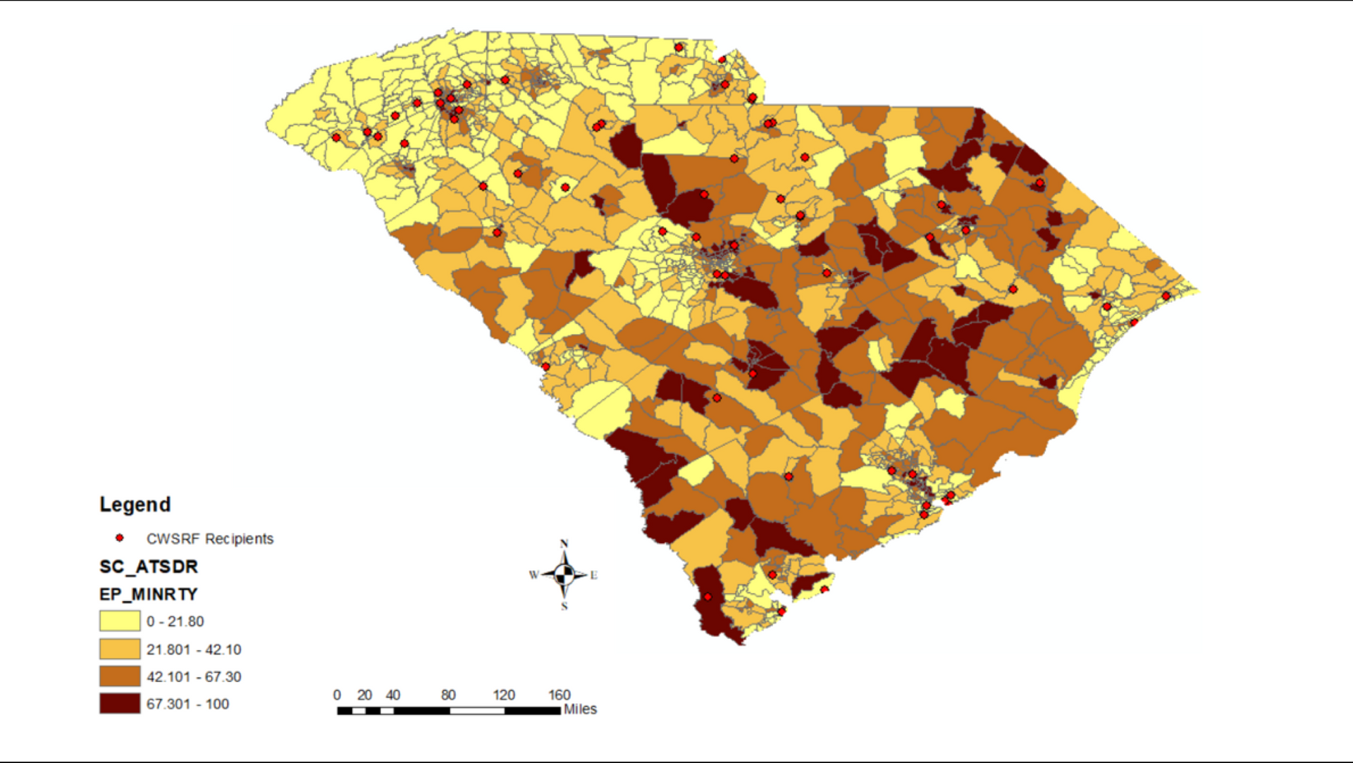
Minority Percentage

Slide 12
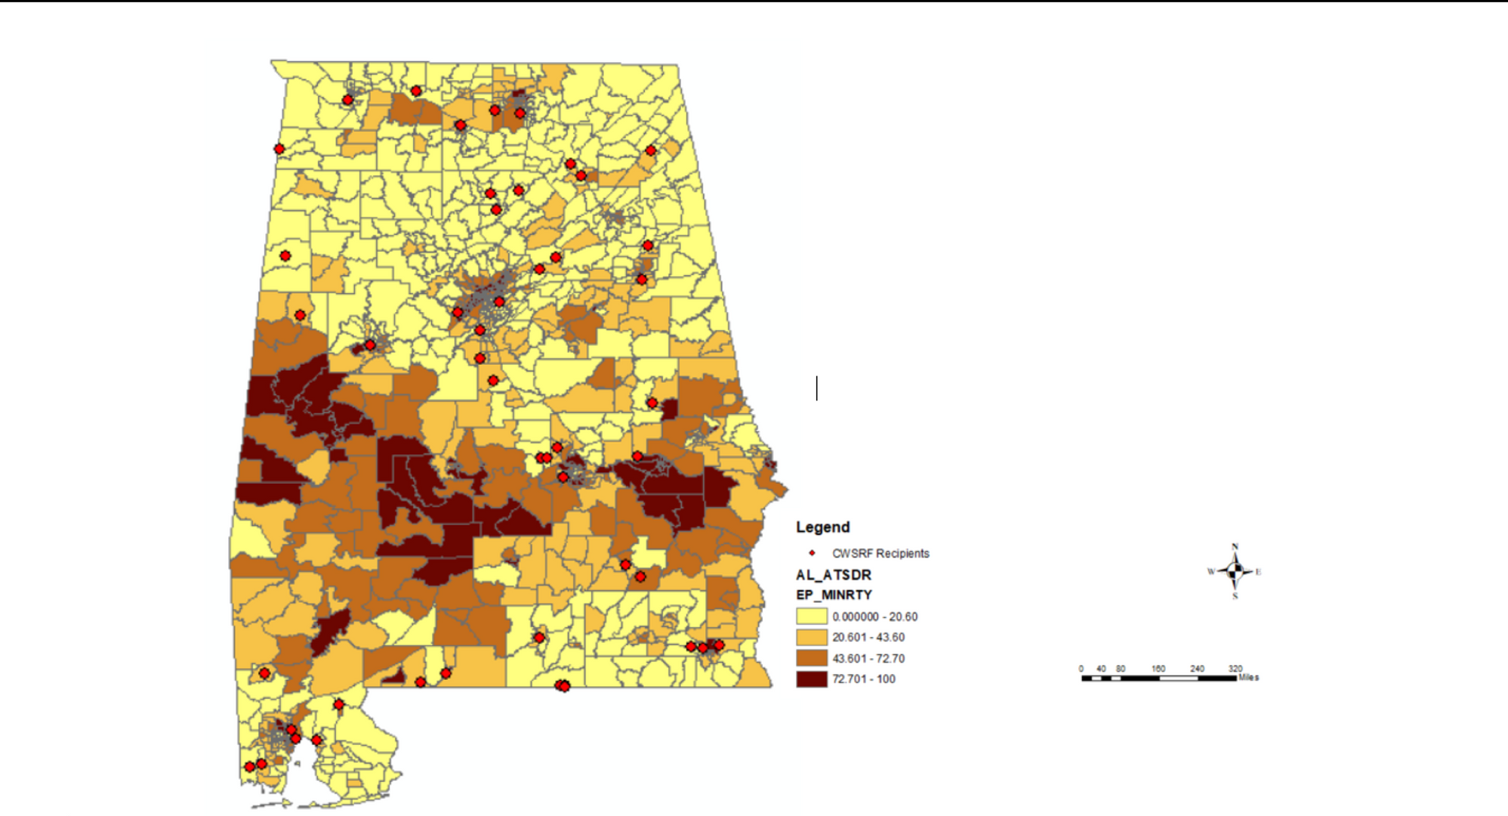
Minority Percentage

Slide 13
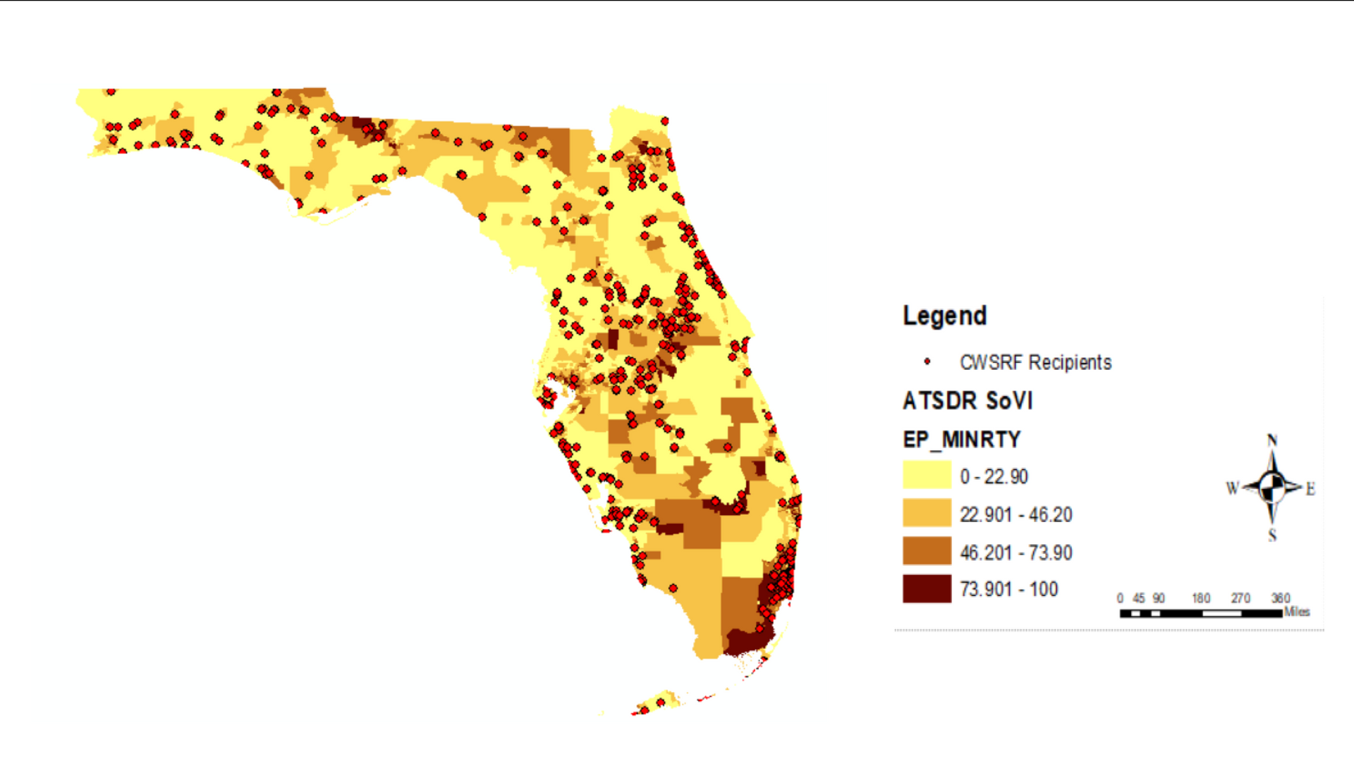
Minority Percentage

Slide 14

How Are We Putting Communities Back in
the Forefront in the Quest for Environmental Equity?
Community
Inclusion
  Engaging end users through advocacy and organizing
  Encouraging community input to determine the makeup of regulatory bodies (i.e. board of directors)
  Including community led research to determine disproportionate impacts

Slide 15
Our Partners
  Florida State Conference NAACP
  Georgia State Conference NAACP
  Mississippi State Conference NAACP
  North Carolina State Conference NAACP
  South Carolina State Conference NAACP
  Tennessee State Conference NAACP
  Jackson State University - Mississippi Urban Research Center
  South Carolina Environmental Coalition

