Slide 1
Moving Mitigation Forward:
The Building Resilient Infrastructure and Communities (BRIC) Program
Hazard Mitigation Assistance, Mitigation Directorate | Federal Insurance and Mitigation Administration, FEMA

Slide 2
FEMA Hazard Mitigation Assistance (HMA)
FEMA manages five mitigation programs with one in development
  Pre-Disaster Programs
    Flood Mitigation Assistance – Mitigate National Flood Insurance Program insured structures
    Pre-Disaster Mitigation– Assists communities in implementing sustained pre-disaster mitigation projects
    Building Resilient Infrastructure and Communities – Provides mitigation for large infrastructure and critical lifelines
  Post Disaster Programs
    Hazard Mitigation Grant Program– Implements hazard mitigation measures after Presidential declared disasters
    HMGP-Post Fire – Provides mitigation funding in burned areas

Slide 3
Historic Funding
Mitigation funding fluctuates year to year based on event occurrences and Congressional appropriations.

Slide 4
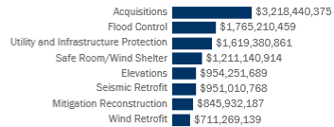
Historic Funding for Major Project Categories
The US states, territories and tribal nations submit grant proposals for mitigation projects.
Projects must be pre-identified in the hazard mitigation plan.
The states, territories and tribes submit proposals that are prioritized at the grantee level for review and approval.

Slide 5
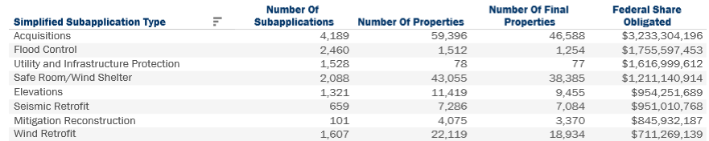
History of Major Mitigation Projects

Slide 6
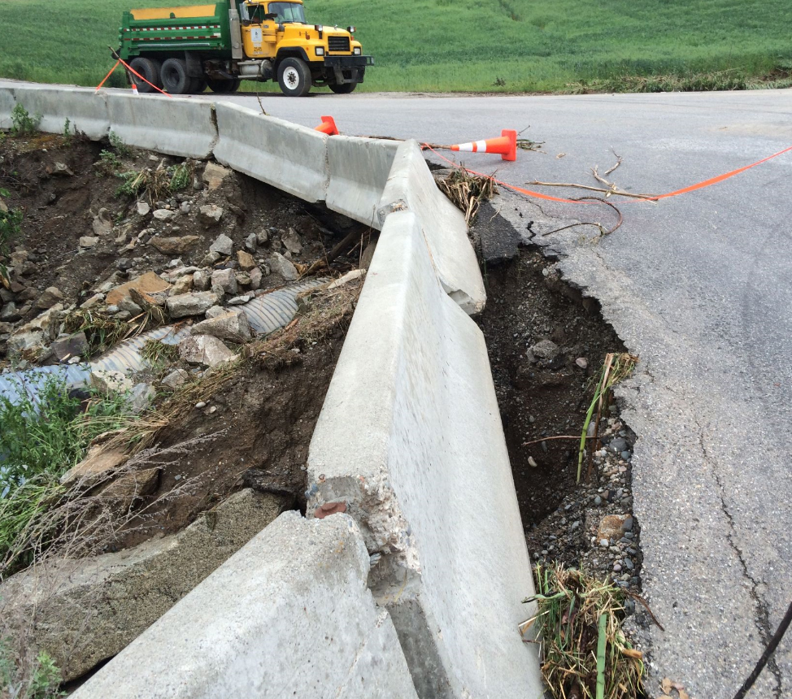
  Disaster Recovery Reform Act (DRRA)
The most significant opportunity in decades to focus on investing year-in and year-out on mitigation measures that will reduce losses from future disaster events
Establishes nearly 50 new authorities and requirements across FEMA
Designed to address the rising costs of disasters and reform Federal disaster programs
6

Slide 7






  DRRA Section 1234: Building Resilient Infrastructure and Communities (BRIC)
FEMA’s goal is to reduce costs and loss of human life from natural hazards by building a national culture of preparedness, encouraging investments to protect our communities and infrastructure, and building mitigation capabilities to foster resilience.
BRIC Guiding Principles
  Support communities through capability & capacity building
  Encourage and enable innovation
  Promote partnerships
  Enable large projects
  Maintain flexibility
  Provide consistency
Since 2009, FEMA has received approximately $1 billion in Pre-Disaster Mitigation grant appropriations, of which 48% has been in the last 2 years.
Average amount from 2009-2016:
$56M/year.
Avg. from 2017-2019:
$200M/year.
Funds will vary based on disasters. FIMA estimates that annual funds will average $300M-$500M per year, with significantly greater amounts following years with catastrophic disasters.

Slide 8
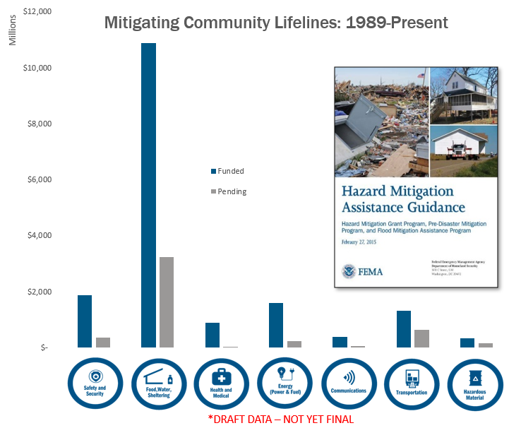
Infrastructure and Lifeline Considerations
Project types
Period of Performance
Advance Assistance opportunities
Private sector ownership
New technical considerations
Role of planning
Technical assistance needs
Funding amounts and caps
Nature-based infrastructure

Slide 9
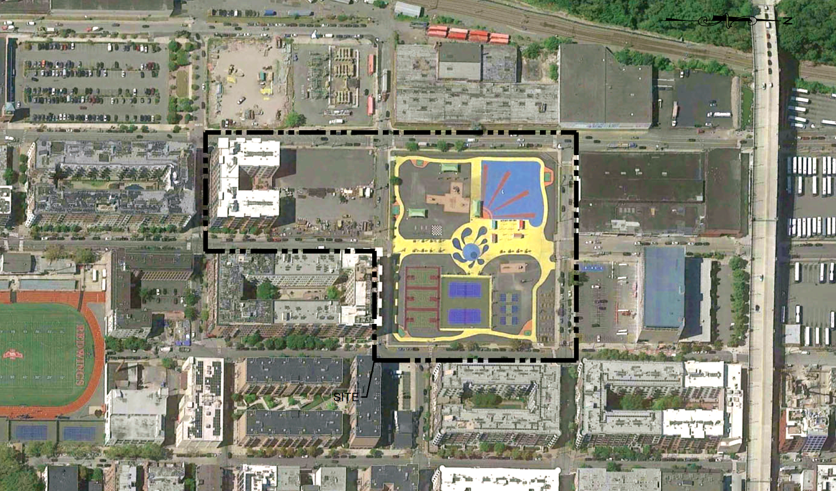
  Resilient Infrastructure: Example
6-acre underground resiliency park in NJ offers outdoor public recreation amenities such as a natural oasis, athletic fields, play areas, fitness stations, and event space:
  Lowered basketball court provides
  green stormwater storage
  Rain gardens for capture and filtration
Provides significant mitigation of fluvial and flash flooding for multi-story residential, commercial, and industrial properties
Reduces economic, environmental, and social impacts
8
Drainage areas
7
Landscape types
1.75^{M}
Gallons
of stormwater
storage
$10^{M}
FED SHARE
+
$47^{M}
MATCH

Slide 10
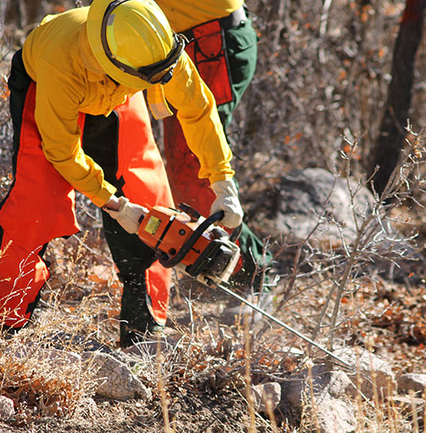
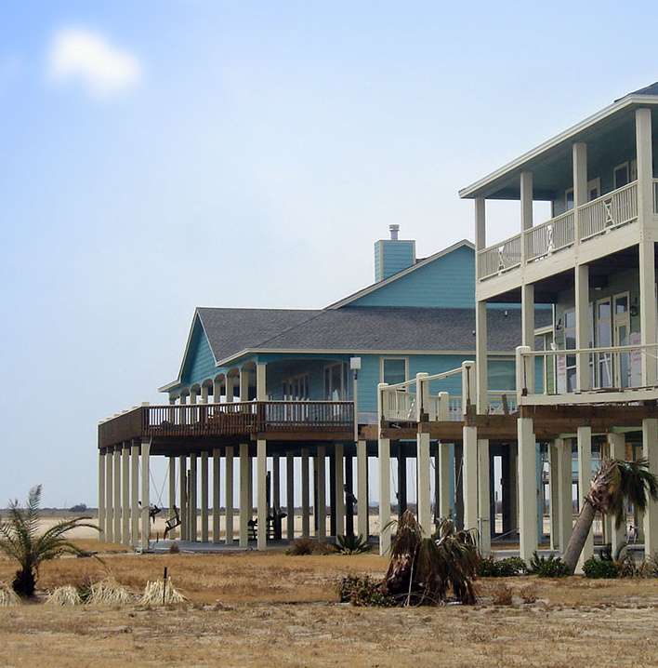

  BRIC Supports FEMA’s Priorities
Build a culture of preparedness
Prepare the nation for catastrophic disasters
Reduce complexities
BUILDBRIC@fema.dhs.gov

