Slide 1
Effect of Processing Techniques on the Insulation Properties of Amorphous PLA Foams
Department of Mechanical and Energy Engineering
Kayode E Oluwabunmi, Mariela Alvarez and Nandika D’Souza

Slide 2
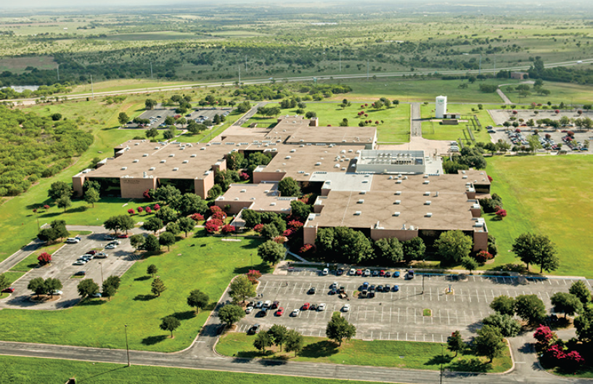
Introduction
Department of Mechanical and Energy Engineering
I am a PhD Candidate at the University of North Texas in the Mechanical and Energy Engineering Department.
I have been studying in Dr Nandika D’ Souza’s group where we research ways to develop bio-based polymer composite materials.
My current area of research is primarily focused on the development of bio-based composite foams for insulation applications in buildings .
Funded by the National Science Foundation (NSF).

Slide 3
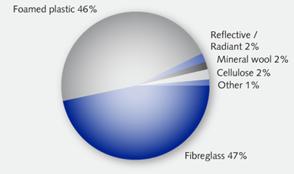
Overview
Department of Mechanical and Energy Engineering
As the standard of living keeps improving, the need to balance human comfort with environmental impact keeps improving as well.
What this means is that we have to look at what the materials we use to construct where we live and work are made and sourced.
It has been estimated that the worth of global building insulation will reach USD 27.74 billion in 2022, from its current USD 22.24 billion [1].
This leads us to the 2 main issues of concern.
Courtsey; Technavio Research [1]

Slide 4
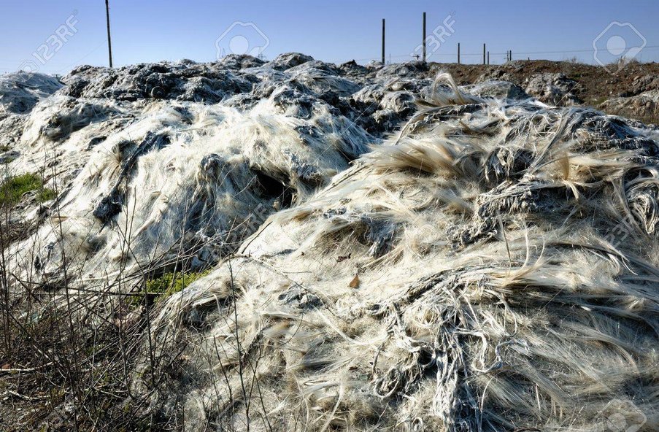
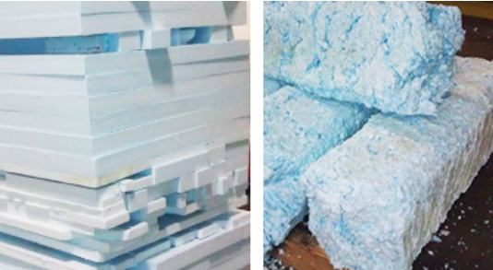
Disposal/Health Issues
Department of Mechanical and Energy Engineering
Most foamed and non-foamed insulations are majorly non- renewable products (petroleum-based, fiber glass, mineral wool, batt).
They yield increasing unrecyclable eco-unfriendly waste at the end of their lives ; styrene, polyurethane generate over 100,000 kg of waste insulation in US alone yearly [3].
Polyurethane contains the same amount of energy as coal [3].
Most of the processing techniques and blowing agents are cancerous and injurious to health when inhaled.
Courtsey; Eurima Health & Safety [2]
Landfill of insulation waste glass fiber [3], Polystyrene waste [4]

Slide 5
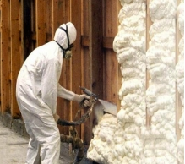
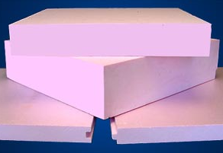
Energy & carbon footprint
Department of Mechanical and Energy Engineering
Increase in energy consumption/ carbon footprint.
According to the United Nations Environment Prog. (UNEP) and the World Meteorological Org.(WMO), 40 % of global electricity consumption leads to about 36 % of the global carbon emissions (CO₂) [5].
This is because the current insulation manufacturing techniques require high temperature and pressure conditions.
High energy demands
High carbon foot prints
Energy inefficiency of the current insulation materials because of the processing techniques and raw materials used in making them.
[4]

Slide 6
Polylactic acid
Department of Mechanical and Energy Engineering
Why PLA ?
PLA is made from corn and corn helps to store carbon which helps its grow by taking CO₂ out of the atmosphere .
PLA has better thermal processability when compared to other biopolymers.
PLA requires 25–55% less energy to produce than petroleum-based polymers and can be further reduced to less than 10% in the future.
PLA possesses favorable properties when foamed with supercritical CO₂(ScCO₂).

Slide 7
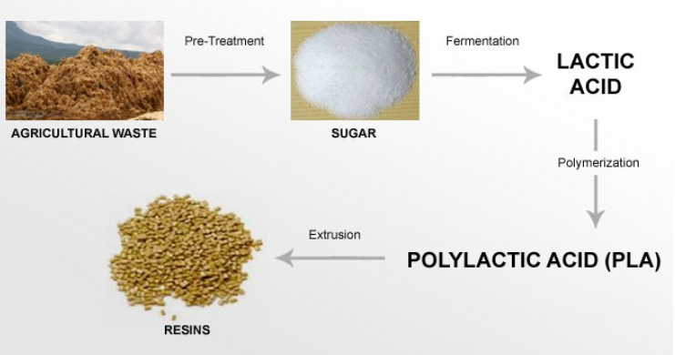
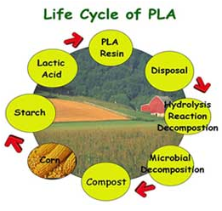
PLA Life Cycle
Department of Mechanical and Energy Engineering
[6]
[7]

Slide 8
Supercritical Carbon dioxide (scCO₂)
Department of Mechanical and Energy Engineering
scCO₂, is relatively cheap, nontoxic, and nonflammable.
Storing carbon, taking CO₂ from the atmosphere and putting them in foams
No phase separation occurs for any substance at pressures or temperatures above its critical values, because gas and liquid co-exist in equilibrium in this phase.
Adjusting the fluid density most especially around the critical temperature and pressure of T_{c} of 31.1°C and P_{c} of 1,070 psi makes it tunable.
[8]

Slide 9
Batch Foaming
Department of Mechanical and Energy Engineering
Foaming techniques | Pros | Cons
Batch foaming | Can be done on a very small scale. Permits lower temperature and pressure requirements for foaming. Facilitates formation of single-phase polymer/C$O_{2}$ solution | Longer cycle times due to lower gas diffusivity in this system. Small scale production only.
Injection/Extrusion foaming | Short cycle time and improved dimensional stability | Capital and Equipment intensive. Requires high energy consumption because of high temperature and pressure requirements. High heat retention, low melt and shear strength.
Batch foaming process is also called solid state foaming or autoclave method.
In batch foaming, the polymer samples are placed in high pressure chamber to be saturated with scCO₂ the blowing agent.
By manipulating the saturation and foaming temperature, saturation pressure, soaking time around the glass transition temperature a thermodynamic instability can be induced that leads to cellular nucleation and subsequent growth [9].
With this the foam cellular morphology and properties can be controlled.
Foaming methods
Thermal soak
Pressure- quench
For cells to grow
i ${ R}_{cr}$ = $\frac{2 γ_{lg}}{P_{bub, cr −P_{sys}}}$ < $R_{cell}$
ii $ΔG_{sys}<0$

Slide 10
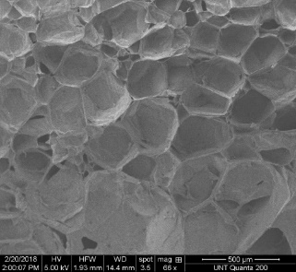
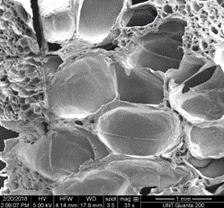
Background
Department of Mechanical and Energy Engineering
Generally, thermoplastic foams made through the physical foaming process experience complex stages of dissolution, bubble growth and coalescence . This significantly impacts their cellular architecture.
Cell control during the manufacturing process is key to obtaining the resultant performance properties of foams.
Types of foams cells
Closed cell foams
Mixed Cell foams
Open cell foams
Closed cells are distinct and surrounded by thin cell walls and sealed off from neighboring cells [10-11]
Open cell foams have more open porosity and more struts. [10-11].
Closed cell foam structure
Mixed cell bimodal structure
Open cell foam structure

Slide 11
Effect of Manufacturing Process
Department of Mechanical and Energy Engineering
Manufacturing process
Control of cellular architecture and morphology
Optimum thermal, sound absorption insulation
Improved thermal, sound insulation performance
Energy savings + Greener environment + Improved air quality + lower health risks.
Materials | Thermal conductivity (W/m^2K) | Sound absorption coefficient
Polyurethane/ Reinforced Polyurethane | 0.025-0.05 | 0.731-0.887
Expanded Polystyrene | 0.023-0.045 | 0.35-0.55
PLA PLA blended foams | 0.035-0.06 | 0.76 - 0.89
Mineral wool/Glass fiber | 0.04-0.065 | 0.5-0.99
[13 -14]

Slide 12
Objectives
Department of Mechanical and Energy Engineering
Develop a new generation of biodegradable polymer foams for building insulation applications from PLA using the batch foaming process with CO₂ as blowing agent.
Compare the effect of two different processing techniques on the resultant cellular morphology and the thermal and acoustic insulation properties of the PLA foams.

Slide 13
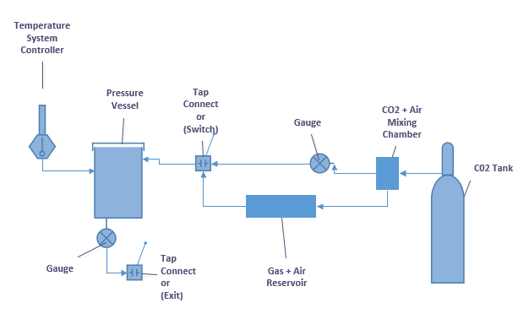
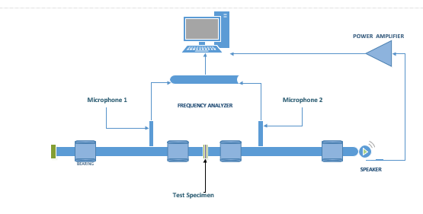
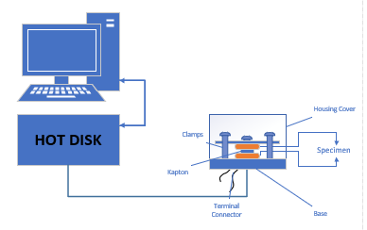
Experimental/Characterization setup
Department of Mechanical and Energy Engineering
Setup for Foaming
Hotdisk for Thermal Conductivity
Impedance tube for Sound Absorption

Slide 14
Foaming Parameters for Sorption Test
Department of Mechanical and Energy Engineering
Varied Temperature (C) | Fixed Pressure (MPa)
23 | 2.07
31 | 3.10
45 | 4.14
58 | 6.21
70 | 8.27
Fixed Temperature (C) | Varied Pressure (MPa)
23 | 2.07
31 | 3.10
45 | 4.14
58 | 6.21
70 | 8.27
Experimental combinations for varied temperature (ºC) at fixed pressure (Mpa)
Experimental combinations for varied pressure (MPa at fixed temperature (ºC)

Slide 15
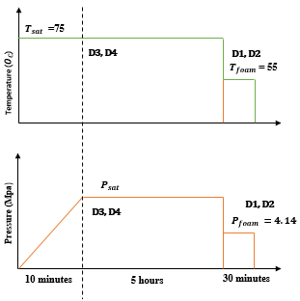
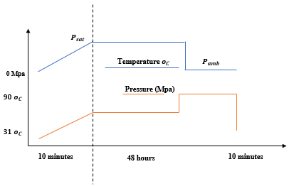
Schematics for the Batch Foaming Process
Department of Mechanical and Energy Engineering
Schematics for the Thermal Soak Process
Schematics for the Decompression Process

Slide 16
Results and Discussions
Department of Mechanical and Energy Engineering

Slide 17
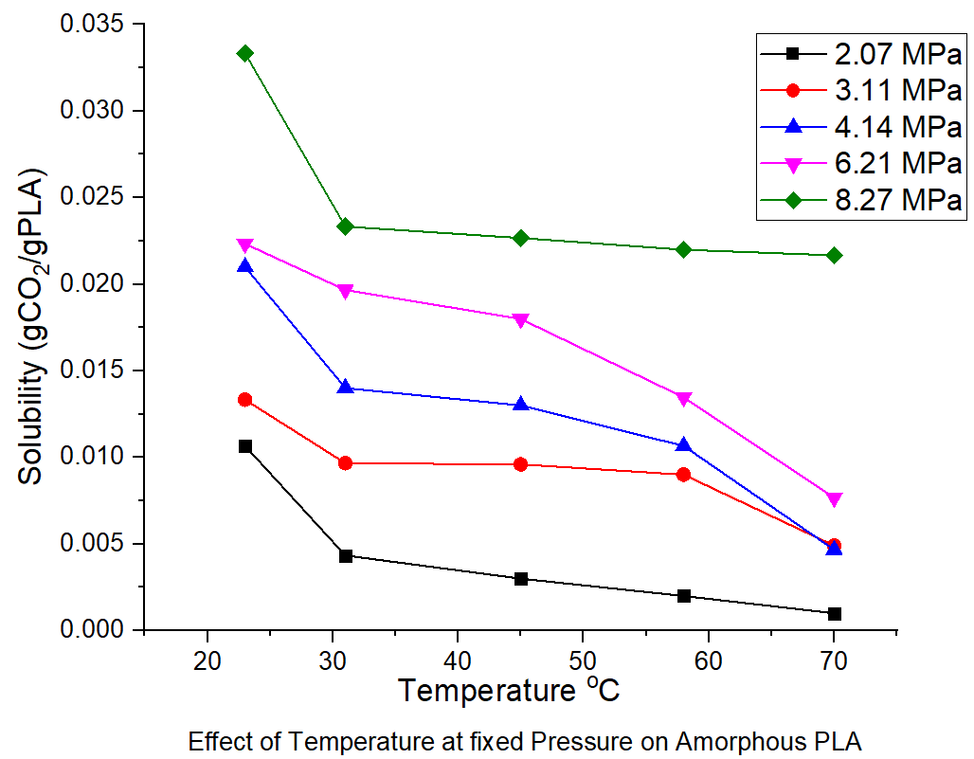
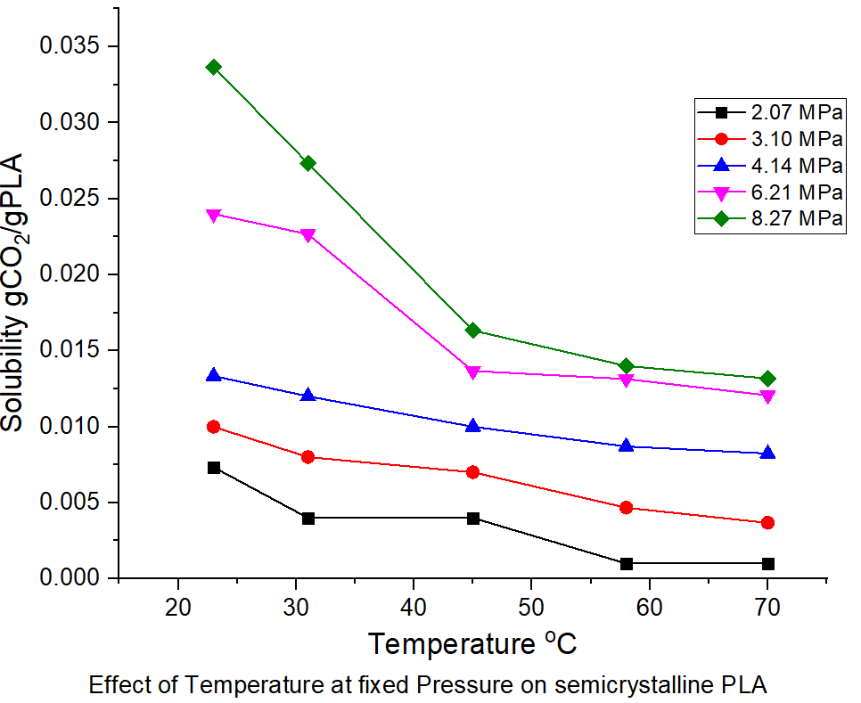
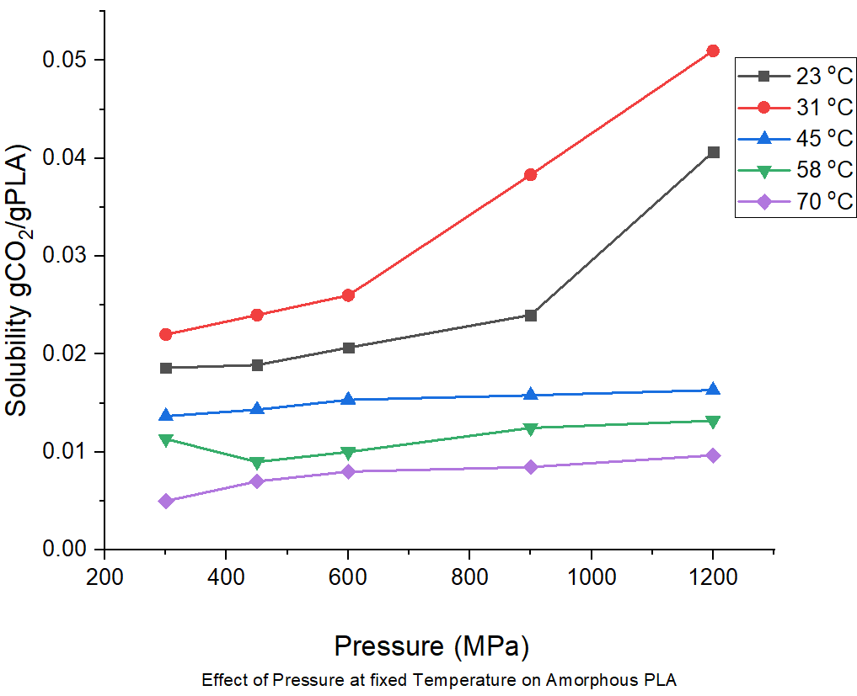
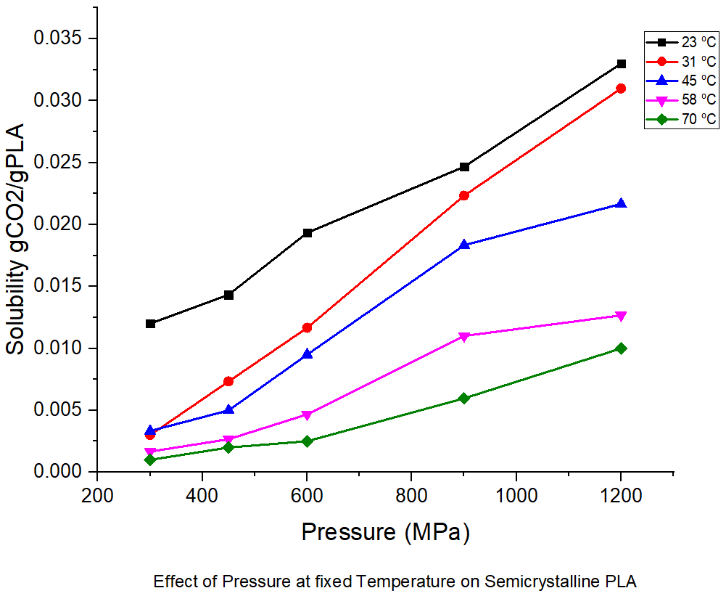
Results of Sorption tests
Department of Mechanical and Energy Engineering
A higher solubility of about 40 % was recorded for the amorphous grade compared to the semi-crystalline grade.

Slide 18
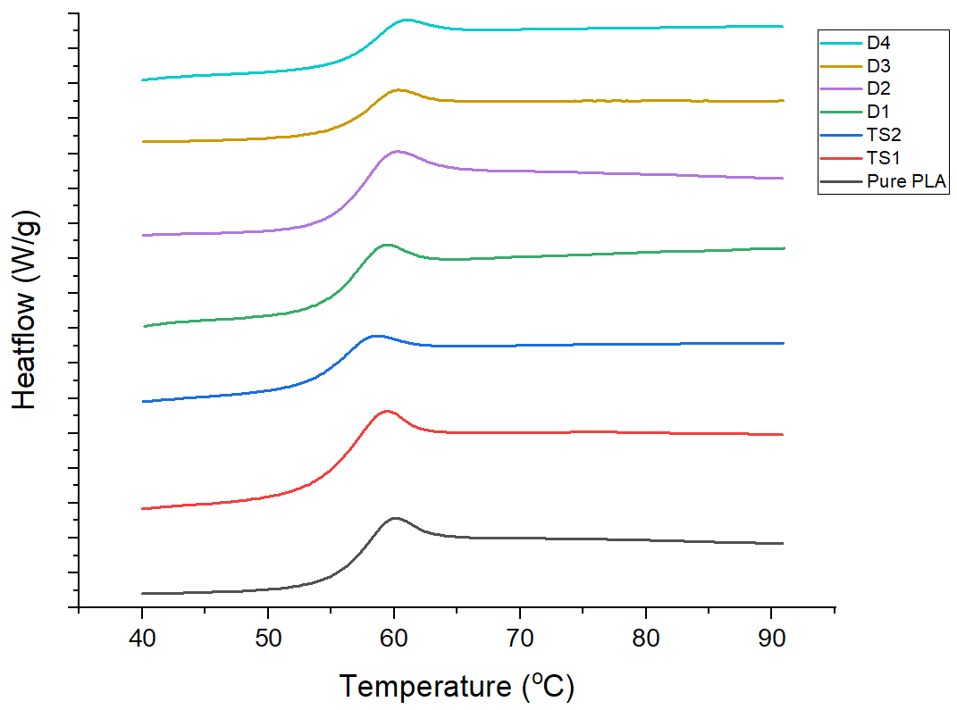
DSC Results of Foams
Department of Mechanical and Energy Engineering
Foam Type | First Cycle T g (ºC) | Second Cycle T g (ºC)
TS 1 | 59.16 | 59.34
TS 2 | 59.69 | 59.37
D1 | 56.9 | 59.32
D2 | 60.33 | 60.19
D3 | 60.9 | 60.25
D4 | 61.48 | 60.66
Unf PLA | 57.1 | 60

Slide 19
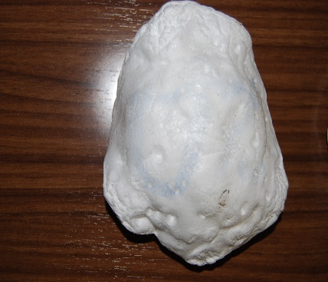
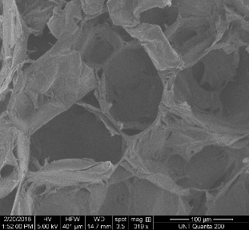
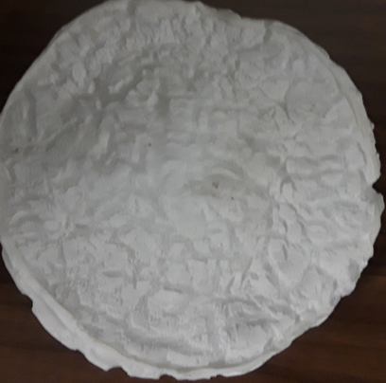
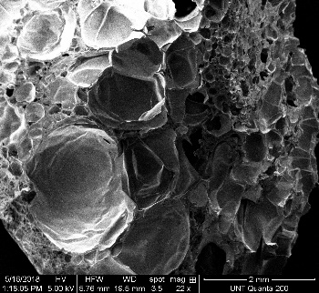
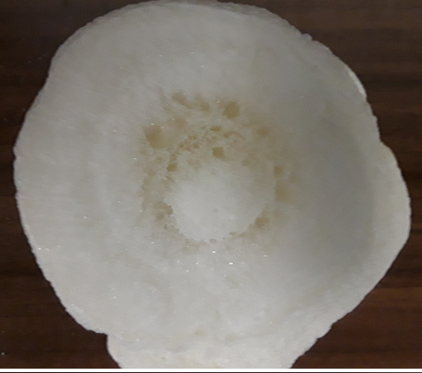
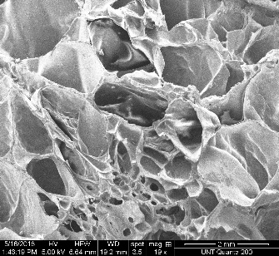
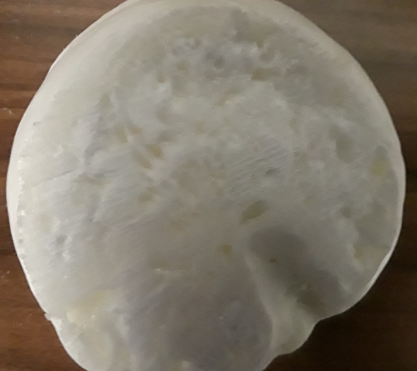
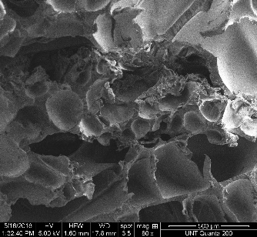
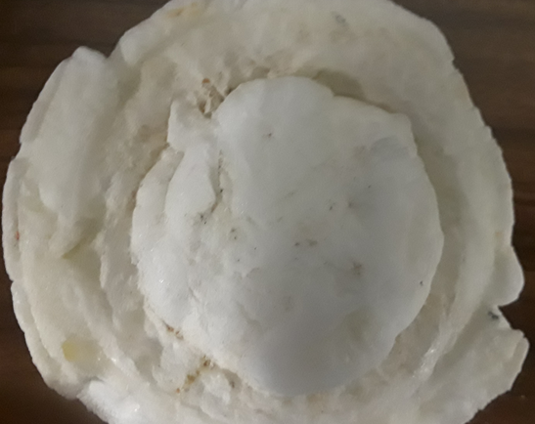
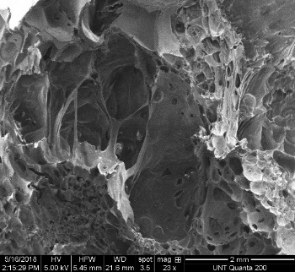
Foam Images
Department of Mechanical and Energy Engineering
TS1
TS2
D1
D2
D3
D4

Slide 20
Cellular Morphology of Foams
Department of Mechanical and Energy Engineering
Foam Type | TS 1 | TS 2 | D1 | D2 | D3 | D4
Density of Unexpanded Polymer (g/cc) | 1.242 | 1.242 | 1.242 | 1.242 | 1.242 | 1.242
Density of Foam ρm (g/cc) | 0.334 ±0.049 | 0.297 ± 0.014 | 0.178 ± 0.0034 | 0.256 ± 0.0078 | 0.098 ± 0.0041 | 0.292 ± 0.0025
Expansion Ratio (%) | 3.723 | 4.188 | 6.983 | 4.851 | 7.8 | 4.26
Average Cell Size (um) | 115.9 ± 16.47 | 109.2 ± 11.52 | 113.61 ± 45.796 | 111.12 ± 20.91 | 150.44 ± 16.84 | 114.06 ±32.12
Cell Density (cell/um³) (E-06) | 1.52 ±0.425 | 2.5 ±0.144 | 3.65 ±4.244 | 2.44 ±0.420 | 2.87 ±3.033 | 1.23± 1.613
Void Fraction (Vf) (%) | 73.141 | 76.12 | 85.679 | 79.385 | 92.103 | 76.527
Open Porosity (%) | 14.52 ± 1.856 | 39.41 ±1.668 | 25.68 ± 1.265 | 42.26 ± 0.63 | 10.51 ±1.822 | 57.35 ±0.252

Slide 21
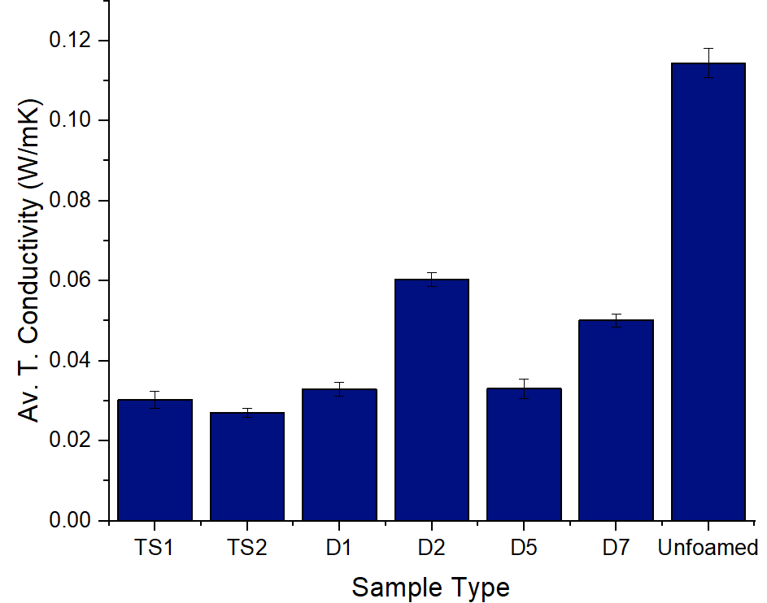
Thermal Conductivity values for the PLA foams
Department of Mechanical and Energy Engineering
Sample Type | T. Conductivity (W/mK)
TS1 | 0.0303
TS2 | 0.027
D1 | 0.03288
D2 | 0.06032
D3 | 0.033
D4 | 0.05008
Unfoamed PLA | 0.185

Slide 22
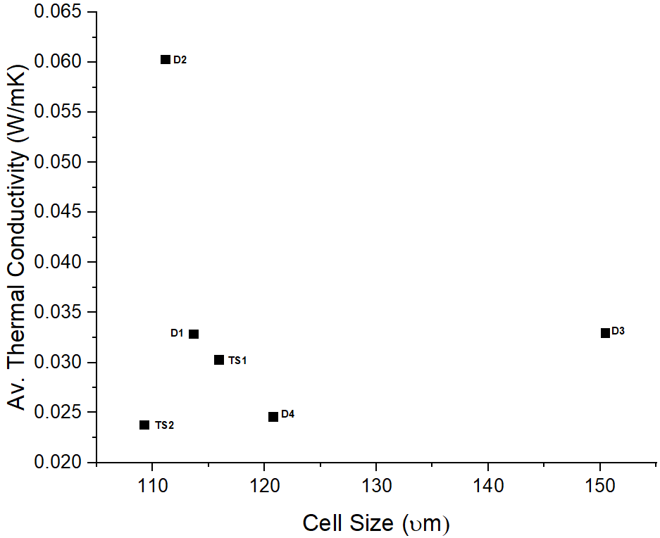
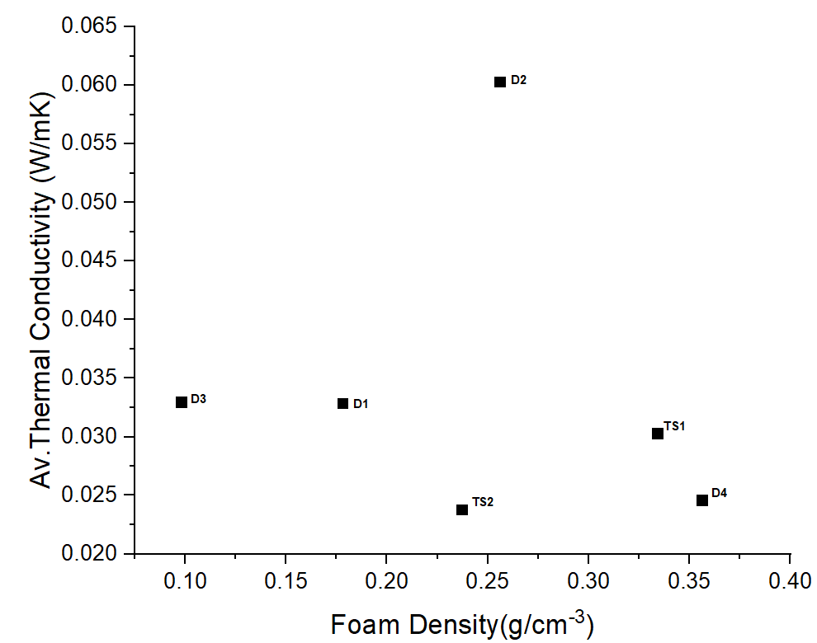
Effect of Cell size, Foam bulk density on Thermal Conductivity of foam
Department of Mechanical and Energy Engineering

Slide 23
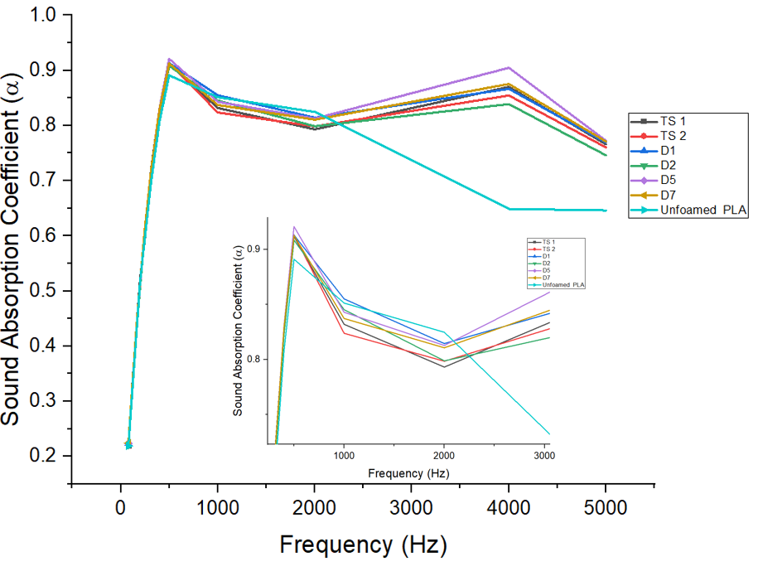
Sound Absorption Properties of PLA Foams
Department of Mechanical and Energy Engineering
Foam Type (Skin test) | F (500 Hz) | F (4000 Hz)
Unfoamed PLA | 0.891 | 0.649
TS2 | 0.912 | 0.87
TS2 | 0.913 | 0.854
D1 | 0.913 | 0.867
D2 | 0.915 | 0.883
D3 | 0.921 | 0.905
D4 | 0.888 | 0.839

Slide 24
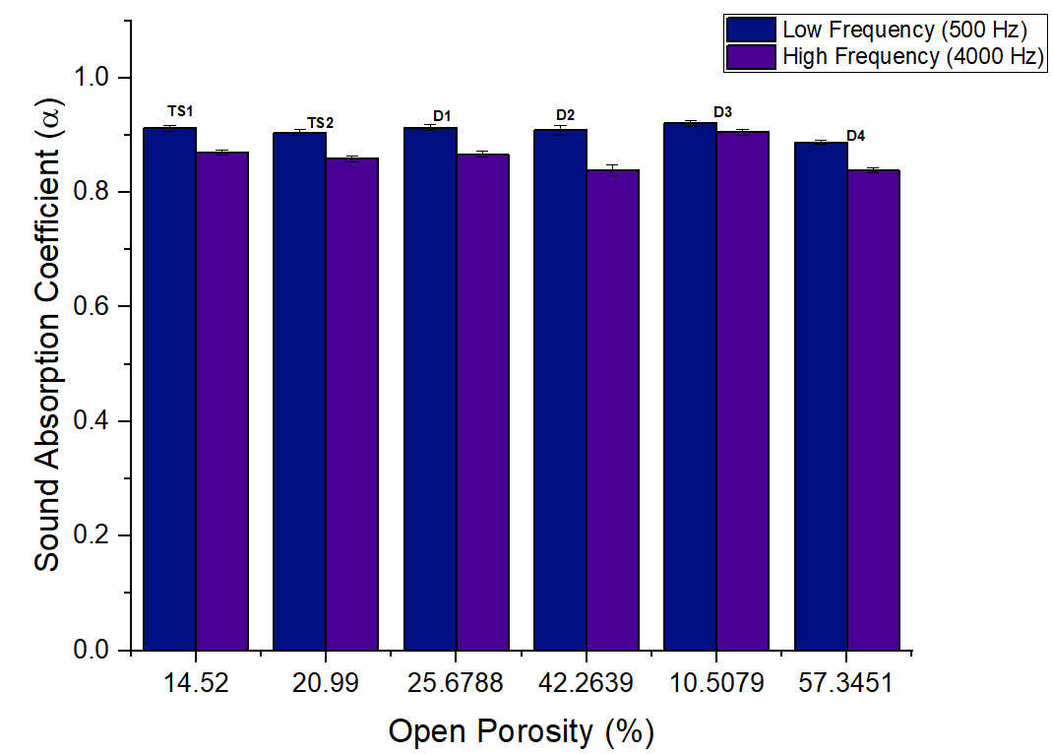
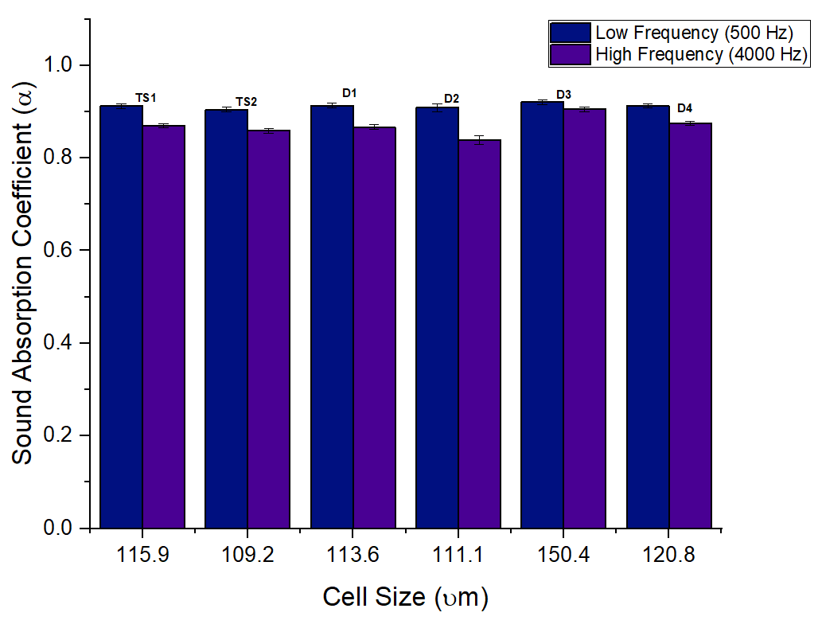
Effect of Open Porosity and Cell size on Sound Absorption Properties of Foams
Department of Mechanical and Energy Engineering

Slide 25
Conclusion
Department of Mechanical and Energy Engineering
Thermal soak and decompression techniques of the batch foaming process was used in manufacturing micro-cellular foams.
Results obtained showed that the foams made through the thermal soak technique had more uniform cellular architecture with lower void fraction and percentage open porosity compared to any of the decompression foams. This contributed to their low thermal conductivity and excellent thermal insulation properties compared to the foams made through decompression.
On the other hand, the foams made through the decompression technique at foaming temperature of 55 ºC had a better mix of cellular architecture due to the bimodal cellular structure compared to the foams made at foaming temperature of 75 º C.

Slide 26
Conclusion (Contd.)
Department of Mechanical and Energy Engineering
Furthermore, they had better sound absorption properties and this could be attributed to their bimodal cellular structure which contained densely packed cells with varying sizes.
Conversely, the foams made at t _{foam} = 75 ºC, had higher percentage open porosity with the highest been about 57 %. This was suspected to have contributed to their superior sound absorption coefficients at both low and high frequencies in comparison to the decompression foams made at t _{foam} = 55 ºC and the thermal soak foams, with open porosity values of 42 % and 21 % respectively.
Finally, it was observed that the range of thermal conductivity values of (0.027 – 0.06) W/mK for the PLA foams made through both techniques were very close to those documented for Extruded Polystyrene (XPS) and Expanded Polystyrene (EPS) (0.03 – 0.06 W/mK). Based on this, the PLA foams made from both methods could serve as potential eco-friendly substitutes for currently used petroleum-based foams.

Slide 27
References
Department of Mechanical and Energy Engineering
[1] Technavio Research; https://www.technavio.com/pressrelease/global-cold-insulation-materials-market-expected-surpass-us-5-billion-2019-revenue
[2] Eurima Health & Safety; https://www.eurima.org/about-mineral-wool/health-safety.html.
[3] Landfill of insulation waste glass fiber https://www.123rf.com/photo_19405245_the-landfill-of-industrial-waste-glass-fiber.html.
[4] W. Yang, Q. Dong, S. Liu, H. Xie, L. Liu, J. Li (2012). The 7th International Conference on Waste Management and Technology. Recycling and disposal methods for polyurethane foam wastes. Procedia Environmental Sciences 16 (2012) 167 – 175. DOI: 10.1016/j.proenv.2012.10.023
[5] http://www.daviddarling.info/encyclopedia/F/AE_foam_board_insulation.html.
[6] http://www.intcorecycling.com/How-to-recycle-xps.html.
[7] https://www.linkedin.com/pulse/polylactic-acid-pla-market-its-way-prolific-growth-shweta-w/.
[8] https://en.wikipedia.org/wiki/Supercritical_carbon_dioxide.
[9] T. Kanai; H. Kawato.; H. Goda. (2003) Control Factors of Foam Structure and Properties in Microcellular Injection Molding. Presented at the Polymer Processing Society 19th Annual Meeting (PPS-19), Melbourne, Australia, July 7-10, 2003.
[10] [11] Lorenz W. Walter Lorenz Surgical Inc. Available at: www.lorenzsurgical.com. Accessed: April 2010.
[11] R C Neagu, M Cuénoud, F Berthold, P E Bourban, E K Gamstedt, M Lindström, J Anders E Månson (2012) Journal of Cellular Plastics. Vol 48, Issue 1, pp. 71 – 103. https://doi.org/10.1177/0021955X11431172.
[13] G. Wypych, 2017 ‘ Handbook of foaming and blowing agents. Chemtec Publishing. Toronto.
[14] K. Sivertsen 2007 ‘ Polymer Foams; 3.063 Polymer Physics.

Slide 28
Questions
Department of Mechanical and Energy Engineering

